Slide 1
Tidyverse Functions I Have Found Helpful
Allison Miller, PT, DPT, PhD, NCS

Slide 2

A Super Helpful Reference
The content and visuals in this presentation are from R for Data Science:
https://r4ds.had.co.nz/index.html
Notes:
The visualizations and content of this presentation are based on this book.

Slide 3
What is tidyverse?
Tidyverse is a collection of R packages that are designed to work together.
dplyr: data manipulation
tidyr: tidying data, changing the shape of data (pivoting)
ggplot2: visualizing data
lubridate: managing data with dates/times
Pipes (% >%): applying a sequence of steps to data (chaining operations)
…..And more!

Slide 4
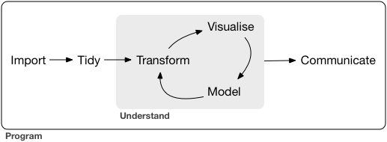
Typical Workflow of Data Analysis

Slide 5
Typical Workflow of Data Analysis

Slide 6
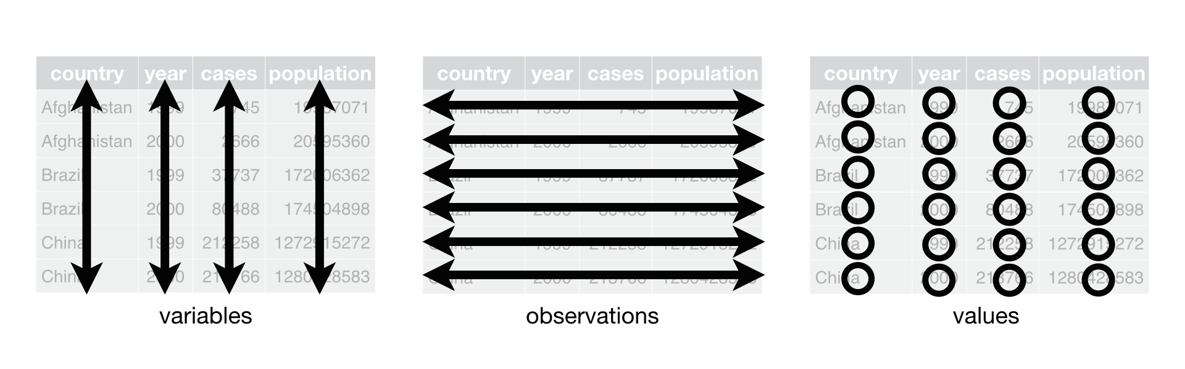
What is tidy data?
Data that is organized in a consistent and easy-to-use fashion
Three interrelated rules which make a dataset tidy:
Each variable must have its own column.
Each observation must have its own row.
Each value must have its own cell.
Notes:
Most of the time, data is not prepared and ready for us in the fashion, so it requires some tidying!

Slide 7
Common Challenges in Tidying Data:
One variable might be spread across multiple columns.
One observation might be scattered across multiple rows.

Slide 8
Common Challenges in Tidying Data:
One variable might be spread across multiple columns.
Tidyverse Solution: pivot_longer
Data %>% pivot_longer(c(Day1, Day2, Day3), names_to = “Day”, values_to = “Steps”)
Participant | Day | Steps
1 | Day1 | 1550
1 | Day2 | 1840
1 | Day3 | 1231
2 | Day1 | 1860
2 | Day2 | 1800
2 | Day3 | 1500
3 | Day1 | 4500
3 | Day2 | 5600
3 | Day3 | 8000
Participant | Day1 | Day2 | Day3
1 | 1550 | 1840 | 1231
2 | 1860 | 1800 | 1500
3 | 4500 | 5600 | 8000
Notes:
To tidy a dataset like this, we need to pivot the offending columns into a new pair of variables. To describe that operation we need three parameters:
The set of columns whose names are values, not variables. In this example, those are the columns Day1_Steps, Day2_Steps, Day3_Steps.
The name of the variable to move the column names to. Here it is Day.
The name of the variable to move the column values to. Here it’s Steps.
pivot_longer() makes datasets longer by increasing the number of rows and decreasing the number of columns.

Slide 9
What about combining two datasets?
Consider: left_join, right_join, full_join
left_join(Data1, Data2, by = c(“Participant”, “Day”))
Participant | Day | Steps
1 | 1 | 1550
1 | 2 | 1840
1 | 3 | 1231
2 | 1 | 1860
2 | 2 | 1800
2 | 3 | 1500
3 | 1 | 4500
3 | 2 | 5600
3 | 3 | 8000
Participant | Day | Sleep (hrs)
1 | 1 | 8
1 | 2 | 6.5
1 | 3 | 7
2 | 1 | 4
2 | 2 | 7
2 | 3 | 6
3 | 1 | 10
3 | 2 | 9
3 | 3 | 8
Participant | Day | Steps | Sleep
1 | 1 | 1550 | 8
1 | 2 | 1840 | 6.5
1 | 3 | 1231 | 7
2 | 1 | 1860 | 4
2 | 2 | 1800 | 7
2 | 3 | 1500 | 6
3 | 1 | 4500 | 10
3 | 2 | 5600 | 9
3 | 3 | 8000 | 8
Data1
Data2
Notes:
Left_join keeps all observations in X

Slide 10
Common Challenges in Tidying Data:
One observation might be scattered across multiple rows.
Tidyverse Solution: pivot_wider
Data %>% pivot_wider(names_from = Type, values_from = count)
Participant | Day | Type | Count
1 | 1 | Steps | 1550
1 | 1 | Sleep | 8
1 | 2 | Steps | 1840
1 | 2 | Sleep | 6.5
1 | 3 | Steps | 1231
1 | 3 | Sleep | 7
Participant | Day | Steps | Sleep
1 | 1 | 1550 | 8
1 | 2 | 1840 | 6.5
1 | 3 | 1231 | 7
Notes:
pivot_wider() is the opposite of pivot_longer(). You use it when an observation is scattered across multiple rows.
To tidy this up, we first analyse the representation in similar way to pivot_longer(). This time, however, we only need two parameters:
The column to take variable names from. Here, it’s type.
The column to take values from. Here it’s count.
As you might have guessed from their names, pivot_wider() and pivot_longer() are complements. pivot_longer() makes wide tables narrower and longer; pivot_wider() makes long tables shorter and wider.

Slide 11
Data Transformation
Data is typically not in the correct format/convention we need for analysis. We therefore need to make transformations to the data.
Tidyverse offers a variety of functions that can help with this:
Pick observations by their values: filter()
Reorder the rows: arrange()
Reorder the columns: relocate()
Pick variables by their names: select()
Create new variables with functions of existing variables: mutate()
Collapse many values down to a single summary: summarise()
Grouping data: group_by()

Slide 12
Pick observations by their values: filter()
filter(Data, Steps > 4000)
Participant | Day | Steps | Sleep
1 | 1 | 1550 | 8
1 | 2 | 1840 | 6.5
1 | 3 | 1231 | 7
2 | 1 | 1860 | 4
2 | 2 | 1800 | 7
2 | 3 | 1500 | 6
3 | 1 | 4500 | 10
3 | 2 | 5600 | 9
3 | 3 | 8000 | 8
Participant | Day | Steps | Sleep
3 | 1 | 4500 | 10
3 | 2 | 5600 | 9
3 | 3 | 8000 | 8
Notes:
filter() allows you to subset observations based on their values. The first argument is the name of the data frame. The second and subsequent arguments are the expressions that filter the data frame

Slide 13
Reorder the rows: arrange()
arrange(Data, Steps)
Participant | Day | Steps | Sleep
1 | 1 | 1550 | 8
1 | 2 | 1840 | 6.5
1 | 3 | 1231 | 7
2 | 1 | 1860 | 4
2 | 2 | 1800 | 7
2 | 3 | 1500 | 6
3 | 1 | 4500 | 10
3 | 2 | 5600 | 9
3 | 3 | 8000 | 8
Participant | Day | Steps | Sleep
1 | 3 | 1231 | 7
2 | 3 | 1500 | 6
1 | 1 | 1550 | 8
2 | 2 | 1800 | 7
1 | 2 | 1840 | 6.5
2 | 1 | 1860 | 4
3 | 1 | 4500 | 10
3 | 2 | 5600 | 9
3 | 3 | 8000 | 8
Notes:
arrange() works similarly to filter() except that instead of selecting rows, it changes their order. It takes a data frame and a set of column names (or more complicated expressions) to order by. If you provide more than one column name, each additional column will be used to break ties in the values of preceding columns
Use desc() to re-order by a column in descending order:
arrange(flights, desc(dep_delay))

Slide 14
Reorder the columns: relocate()
relocate(Data, Sleep, .before = Steps)
Participant | Day | Steps | Sleep
1 | 1 | 1550 | 8
1 | 2 | 1840 | 6.5
1 | 3 | 1231 | 7
2 | 1 | 1860 | 4
2 | 2 | 1800 | 7
2 | 3 | 1500 | 6
3 | 1 | 4500 | 10
3 | 2 | 5600 | 9
3 | 3 | 8000 | 8
Participant | Day | Sleep | Steps
1 | 1 | 8 | 1550
1 | 2 | 6.5 | 1840
1 | 3 | 7 | 1231
2 | 1 | 4 | 1860
2 | 2 | 7 | 1800
2 | 3 | 6 | 1500
3 | 1 | 10 | 4500
3 | 2 | 9 | 5600
3 | 3 | 8 | 8000

Slide 15
Pick variables by their names: select()
select(Data, Participant, Day, Sleep)
Participant | Day | Steps | Sleep
1 | 1 | 1550 | 8
1 | 2 | 1840 | 6.5
1 | 3 | 1231 | 7
2 | 1 | 1860 | 4
2 | 2 | 1800 | 7
2 | 3 | 1500 | 6
3 | 1 | 4500 | 10
3 | 2 | 5600 | 9
3 | 3 | 8000 | 8
Participant | Day | Sleep
1 | 1 | 8
1 | 2 | 6.5
1 | 3 | 7
2 | 1 | 4
2 | 2 | 7
2 | 3 | 6
3 | 1 | 10
3 | 2 | 9
3 | 3 | 8
Notes:
It’s not uncommon to get datasets with hundreds or even thousands of variables. In this case, the first challenge is often narrowing in on the variables you’re actually interested in. select() allows you to rapidly zoom in on a useful subset using operations based on the names of the variables.

Slide 16
Create new variables from functions of existing variables: mutate()
mutate(Data, StepSleepRatio = Steps/Sleep)
Participant | Day | Steps | Sleep
1 | 1 | 1550 | 8
1 | 2 | 1840 | 6.5
1 | 3 | 1231 | 7
2 | 1 | 1860 | 4
2 | 2 | 1800 | 7
2 | 3 | 1500 | 6
3 | 1 | 4500 | 10
3 | 2 | 5600 | 9
3 | 3 | 8000 | 8
Participant | Day | Steps | Sleep | StepSleepRatio
1 | 1 | 1550 | 8 | 193.75
1 | 2 | 1840 | 6.5 | 283.08
1 | 3 | 1231 | 7 | 175.86
2 | 1 | 1860 | 4 | 465
2 | 2 | 1800 | 7 | 257.14
2 | 3 | 1500 | 6 | 250
3 | 1 | 4500 | 10 | 450
3 | 2 | 5600 | 9 | 622.22
3 | 3 | 8000 | 8 | 1000
Notes:
Besides selecting sets of existing columns, it’s often useful to add new columns that are functions of existing columns. That’s the job of mutate().
mutate() always adds new columns at the end of your dataset.

Slide 17
Collapse many values down to a single summary: summarise()
summarise(Data, AvgSteps = mean(Steps, na.rm = TRUE))
Participant | Day | Steps | Sleep
1 | 1 | 1550 | 8
1 | 2 | 1840 | 6.5
1 | 3 | 1231 | 7
2 | 1 | 1860 | 4
2 | 2 | 1800 | 7
2 | 3 | 1500 | 6
3 | 1 | 4500 | 10
3 | 2 | 5600 | 9
3 | 3 | 8000 | 8
AvgSteps
3097.89
Notes:
The last key verb is summarise(). It collapses a data frame to a single row

Slide 18
Grouping data: group_by()
Data %>% group_by(Participant) %>% summarise(AvgSteps = mean(Steps, na.rm = TRUE))
Participant | Day | Steps | Sleep
1 | 1 | 1550 | 8
1 | 2 | 1840 | 6.5
1 | 3 | 1231 | 7
2 | 1 | 1860 | 4
2 | 2 | 1800 | 7
2 | 3 | 1500 | 6
3 | 1 | 4500 | 10
3 | 2 | 5600 | 9
3 | 3 | 8000 | 8
Participant | AvgSteps
1 | 1540.33
2 | 1720
3 | 6033.33
Notes:
summarise() is not terribly useful unless we pair it with group_by(). This changes the unit of analysis from the complete dataset to individual groups. Then, when you use the dplyr verbs on a grouped data frame they’ll be automatically applied “by group”.

